Slide 1
ORGANIC AGRICULTURE EXCHANGE FORUM 2025
SOKOINE UNIVERSITY OF AGRICUTURE, ICE
13/03/2025

Slide 2
CONCEPT AND GENESIS OF ORGANIC AGRICULTURE
Dr. LILIAN F. SHECHAMBO (PhD)
Horticulture, Crop Protection, Organic Agriculture
Sokoine University of Agriculture
Department of Crop Science and Horticulture
Morogoro, Tanzania

Slide 3
CONCEPT AND GENESIS OF ORGANIC AGRICULTURE
Introduction
Concept of OA
Genesis of OA
Defining OA
Principles of OA
Traditional vs Organic Agriculture
Overview of the current developments in OA
Conclusion

Slide 4
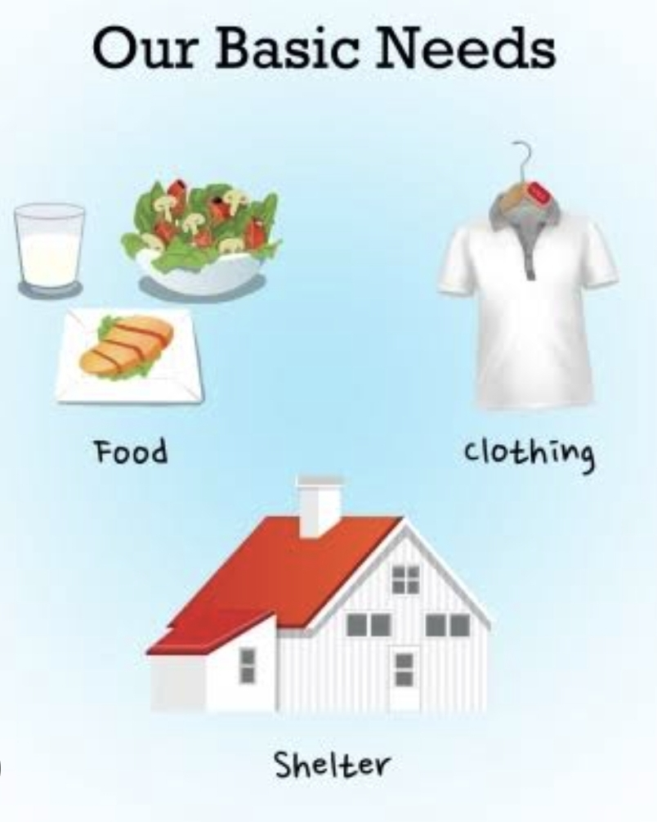
Introduction
Basic human needs are made available in the environment- land, water and air which supports all life

Slide 5
Introduction…
On land-plants are grown for food, fibre, raw materials and for aesthetic value (ornamental plants-flowers, foliages, hedges)
On land-animals are kept-for food, other products (raw materials)
In water-aquatic animals, aquatic plants live, thrive, reproduce, and multiply for food and raw materials
This environment means everything to human beings and all other organisms and earns the right to be protected at all costs for the current needs and for the future generations of all organisms.

Slide 6
Introduction….
Current concerns on the environment
Climate change-global warming, pollution
Extinction of some organisms-both animals, and plants (natural vegetation)
Soil fertility
Health of living organisms
Suffering especially in LDCs

Slide 7
The concept of OA

Slide 8
Concept of OA….
Farmers in modern agriculture apply high levels of fertilisers, pesticides, disinfectants & growth regulators to maximize yield and profitability
High applications of these chemicals in lead to ill-effects to the environment and humans resulting in non-sustainable agriculture
The concept of OA emerged out of concerns on the environment, soils, organisms and their health and also the future generations!
New outlook rooted towards sustainable and ecologically friendly agriculture known as organic farming

Slide 9
Genesis of OA
The organic movement began in the 1930s and 1940s as a reaction to agriculture's growing reliance on synthetic fertilizers.
Artificial fertilizers had been created during the 18th century, initially with superphosphates and then ammonia-based fertilizers were produced.
These early fertilizers were cheap, powerful, and easy to transport in bulk.
Similar advances occurred in chemical pesticides in the 1940s, leading to the decade being referred to as the 'pesticide era'.

Slide 10
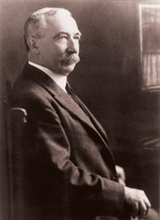
Genesis of OA…
The health of soil, plant, animal and man is one and indivisible”
Sir Albert Howard
1873-1947
Sir Albert Howard is widely considered to be the father of organic farming.
Further work was done by J.I. Rodale in the United States, Lady Eve Balfour in the United Kingdom, and many others across the world.

Slide 11
Genesis of OA…
As environmental awareness and concern increased amongst the general population, the originally supply-driven movement became demand-driven.
Premium prices and some government subsidies attracted farmers.
In other cases, some farmers have converted to organic farming for economic reasons.
Organic farming implies concern with economic as well as environmental and social aspects of farming

Slide 12
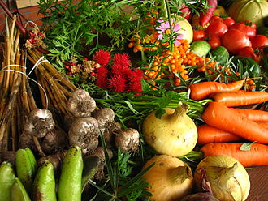
Defining OA
Synonyms of OA
Humus farming
Biological farming
Biodynamic farming
Ecological agriculture
Sustainable agriculture
Regenerative agriculture
Alternative agriculture

Slide 13
Definition of organic farming
Organic farming is an integrated farming system that strives for sustainability, the enhancement of soil fertility and biological diversity whilst, with rare exceptions, prohibiting synthetic pesticides, antibiotics, synthetic fertilizers, genetically modified organisms and growth hormones.
(Treadwell et al.,2026; Rhoads, 2016)

Slide 14
Defining OA…
Organic farming is a production which avoids or largely excludes use of synthetically compounded chemicals such as;
Inorganic fertilizers for Soil fertility management
Synthetic pesticides for pest management
Growth regulators for promoting plant growth and development
Disinfectants for management of microbial decay of fresh produce

Slide 15
Defining OA…
OA includes agricultural systems that promote the enviromentally, socially and economically sound production of
food,
Feed,
fibres and
increasingly the production of fuel and feedstocks for industrial and speciality products such as pharmaceuticals.

Slide 16
Principles of OA
Principles of OA were established by the International Federation of Organic Agriculture Movements (IFOAM) in 2005.
The aim of the principles is to inspire the organic movement and to describe the purpose of organic agriculture to the wider world.

Slide 17
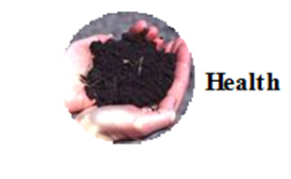
Principles of OA…
1. Principle of Health:
OA should sustain and enhance the health of soil, land, plant, animals and humans as one and indivisible.

Slide 18
Principles of OA…
2. Principle of Ecology:
OA should be based on living ecological systems and cycles, work with them and help sustain them.

Slide 19
Principles of OA…
3. Principle of fairness:
OA should build on the relationships that ensure fairness with regards to the common environment and life opportunities

Slide 20
Principles of OA…
4. Principle of care:
OA should be managed in a precautionary and responsible manner to protect the health and wellbeing of current and future generations and the environment.

Slide 21
Traditional vs Organic Agriculture
Both restrict the use of synthetic inputs and genetically engineered plants and animals
Both promote the use of all natural alternatives as solutions to agricultural challenges
OA promote all known natural methods used in traditional farming plus embracing new technology in
-Doing agricultural farming activities
-Use of new breeds of crops and animals that are high yielding and disease resistant
Organic practice in OA is confirmed by CERTIFICATION.

Slide 22
Overview of the current developments in OA
Economics of OA worldwide
By 2001-US$20billion
By 2014-US$80billion
BY 2024-172.86billion

Slide 23
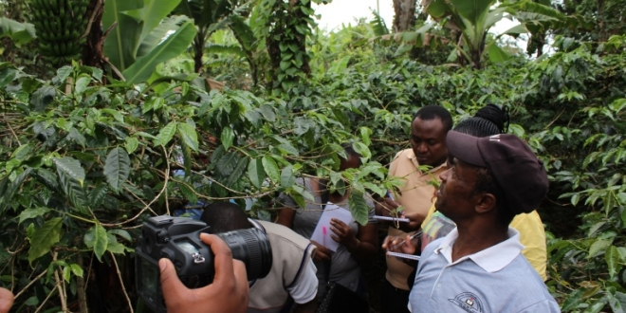
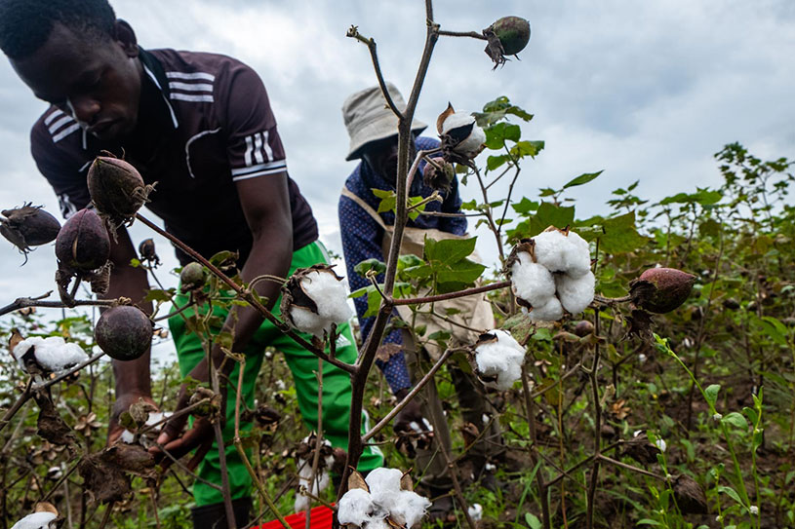
Situation In Tanzania-an overview
Tea and cotton are most important crops grown at large-scale under registered organic farming.
Other produce include black tea, cocoa, ginger, spices, essential oils, honey, cashew nuts, citrus, papaya, guava, mango, banana, onion, garlic and vegetables.

Slide 24
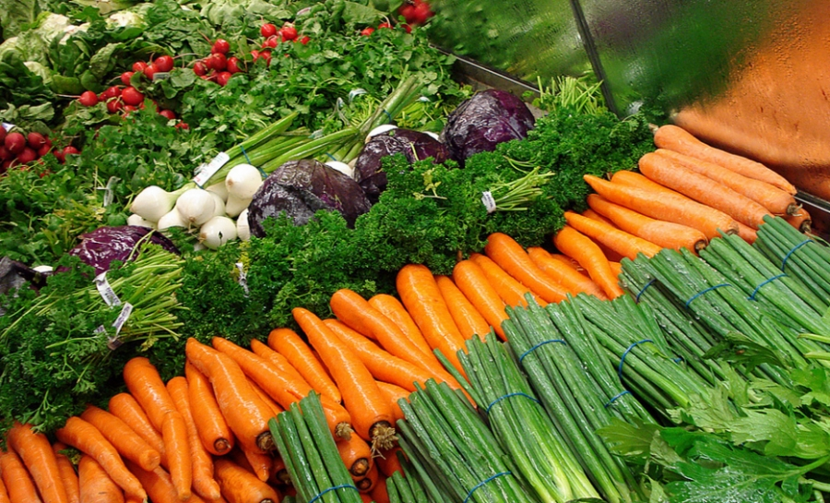
Situation In Tanzania…

Slide 25
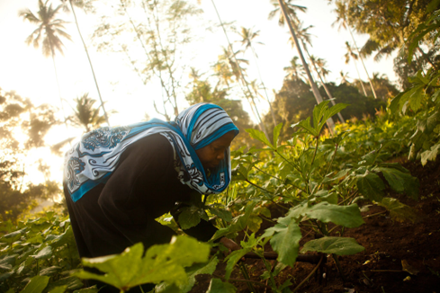
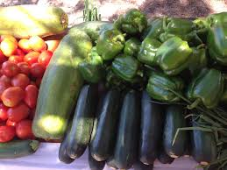
Zanzibar

Slide 26
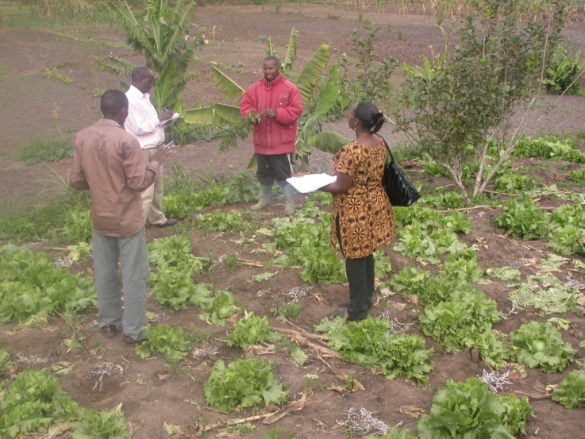
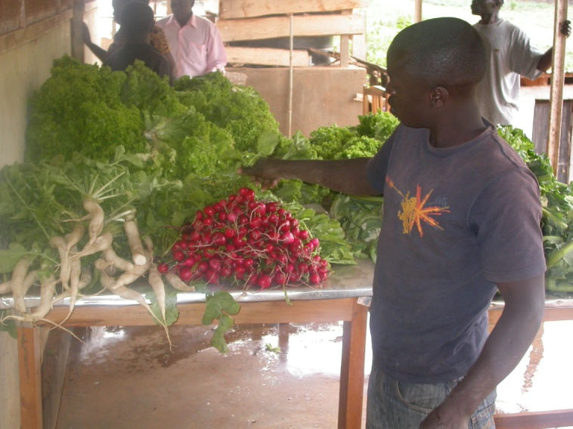
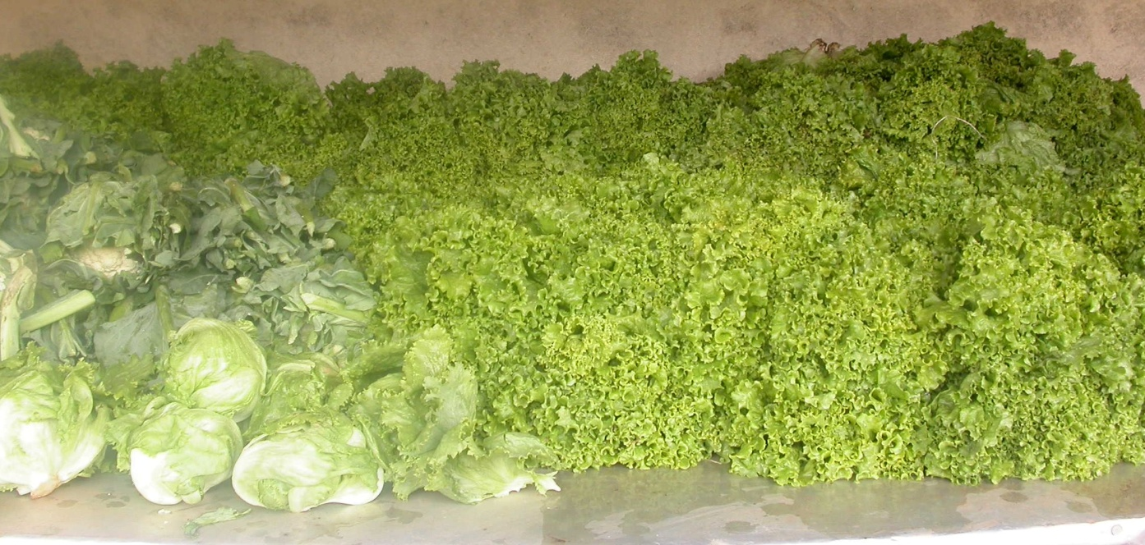
Lushoto-Tanzania
Lettuce, cauliflower, radish, salad and Irish potatoes

Slide 27
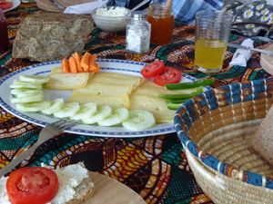
Irente farm-Lushoto, Tanzania
Organic processed and unprocessed food

Slide 28
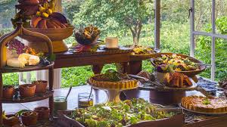
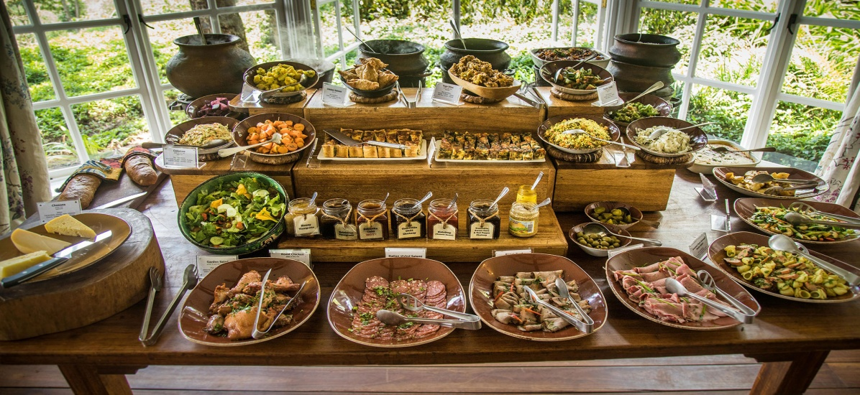
Gibb’s farm-Karatu, Tanzania
Organic farm, organic food

Slide 29
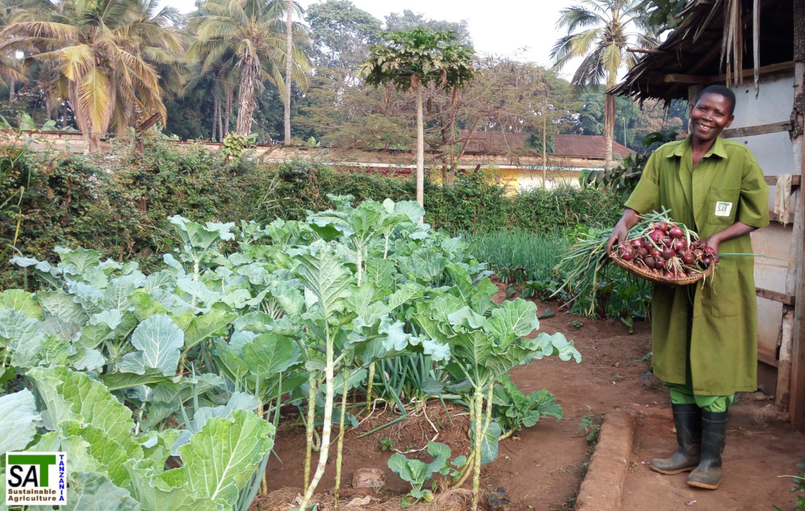
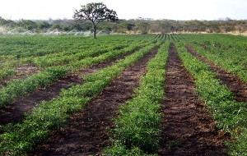
Morogoro-Tanzania

Slide 30
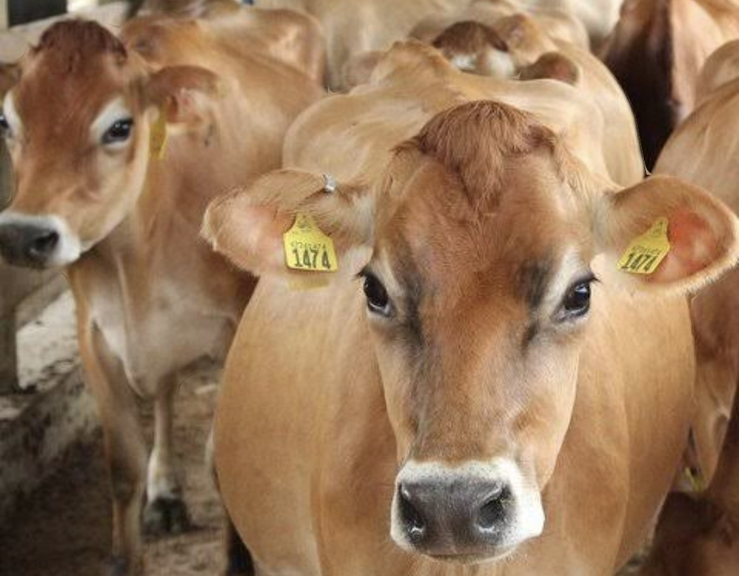
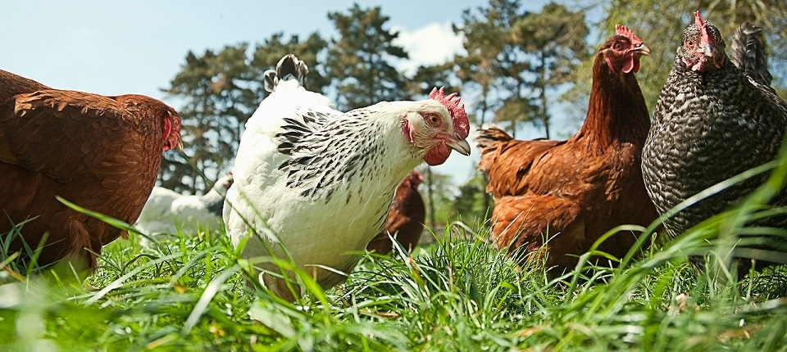
Conclusion

Slide 31
Acknowledgement
Sokoine University of Agriculture
Ministry of Agriculture
Tanzania Organic Agriculture Movement (TOAM)
Sustainable Agriculture Tanzania (SAT)
Farmers groups in all organic production areas in Tanzania

Slide 32
Thank you

